Slide 1
Automatic Door, Light and Security Project
Using PIR Motion Sensor

Slide 2
PROJECT AIM
In this STEM project, we aim to build an electronic device that senses motion using a Passive Infrared (PIR) sensor to control a useful output automatically.
Team 1 aims to create an Automatic Light for a bathroom. The sensor would detect motion and automatically switch the light on or off on entering or exiting the bathroom. This promotes hygiene by removing the need to physically touch a switch and also saves electricity by turning off the lights after exiting
Team 2 will work on a model of an Automatic Sliding Door. The sensor senses motion in front of the door and open the sliding door using a motor and closes it after.
Team 3 will work on an Automatic security buzzer system. The circuit will be installed at the main door and the sensor would detect if someone enters and trigger a buzzer and lock the door for a set amount of time

Slide 3
Automatic Light System
Team 1

Slide 4
Material Required
Arduino UNO R3
PIR (Passive Infrared) sensor
Breadboard
5 V Relay
9V Battery
AC Power Source
220V LED
Insulated wires
Jumper wires

Slide 5
Project Plan
Build a primary circuit consisting of a 220V LED connected to regular 220V AC power supply with a 5V relay attached in between the positive terminals.
The relay would act as a switch to turn on/off the LED which we can control using a digital input. The PIR sensor would detect movement by measuring changes in infrared radiation emitted by any object in its range.
Use the PIR sensor to detect whether someone enters or exits the washroom and input this into the Arduino board to control the relay which in turn controls the LED. Include time delays to ensure that entry and exits are detected only once and the LED is not switched on or off by accident
In case the light is not switched off on exiting the bathroom, a timer is included in the code which set offs after a set amount of time and the light switches off automatically to save electricity

Slide 6
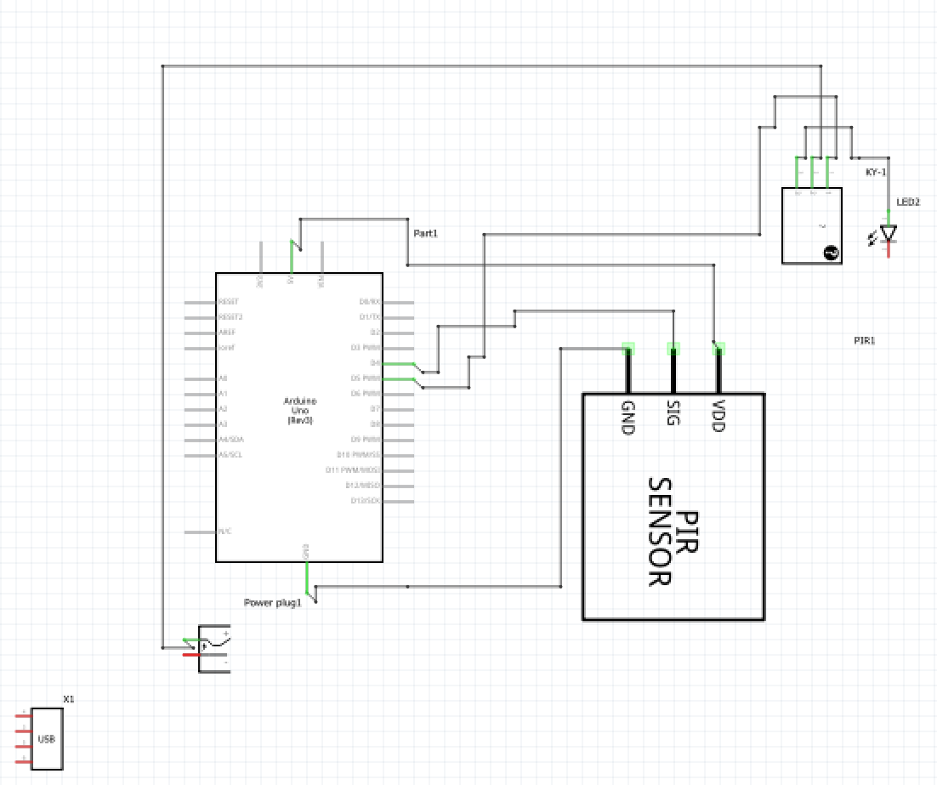
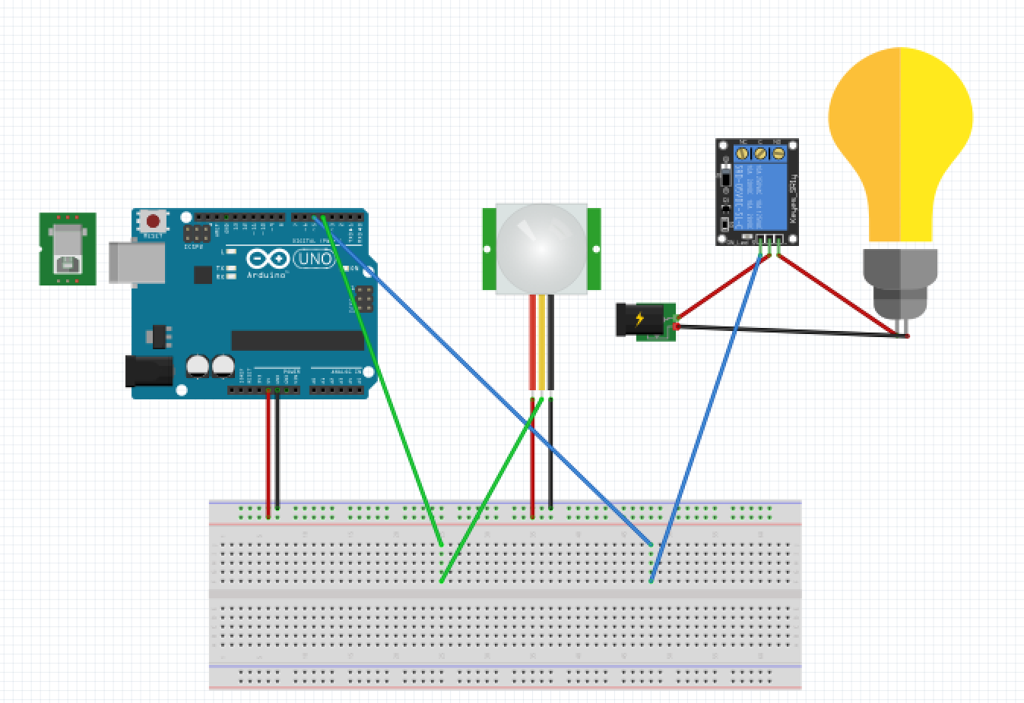
Circuit Diagram

Slide 7
Step by Step Procedure
Simulating the circuit: Creating a simulation of our electronic circuit on the Fritzing software and confirmed its working to be successful.
Writing the code on Arduino IDE, including time delays for the LED and an automatic timer to switch the LED after a set amount of time.
Building the physical circuit: We ordered the components required for our project and started connected them to the Arduino to form the circuit. The circuit worked successfully and after testing it we made some final adjustments to the time delays and timer of the LED.
Then building a 3D model of a box containing the circuit that would be placed on the entry of the bathroom using Tinkercad. The box was open from one surface and contained holes through which the LED, PIR sensor and the insulated wire with plug to connect to a power socket.
Installed the box with the LED, sensor and circuit above the door in the bathroom and tested it to be working successfully

Slide 8
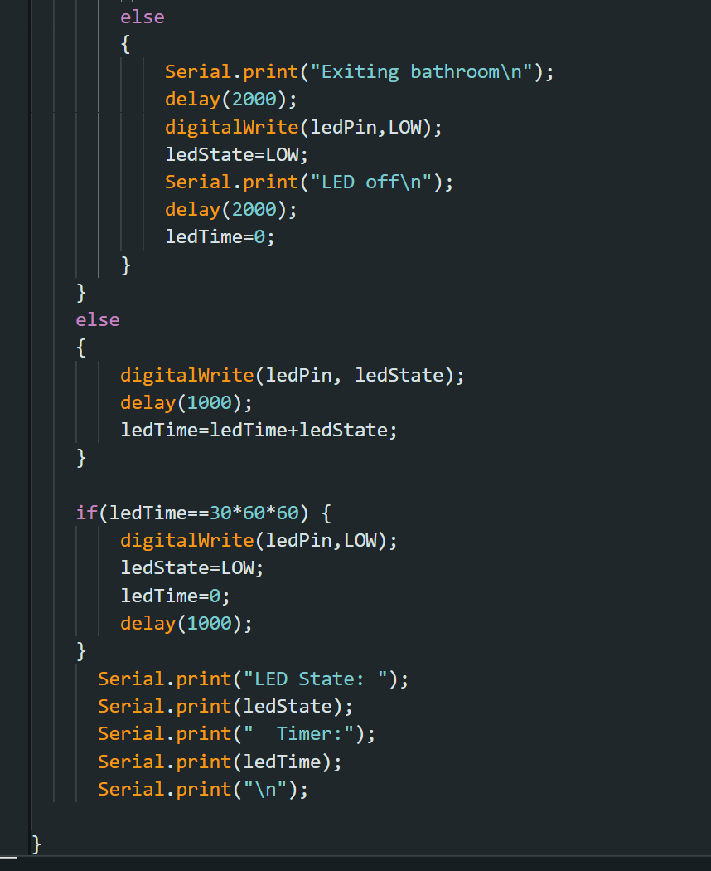
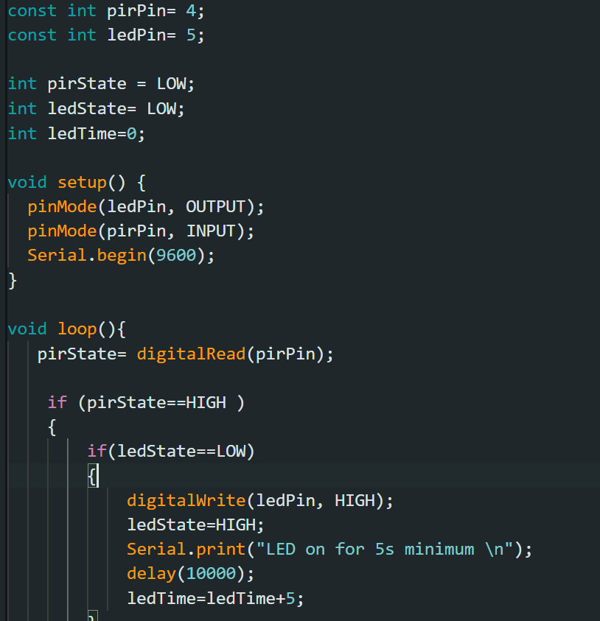
Arduino Code

Slide 9
Automatic Sliding Door
Team 2

Slide 10
Material Required
Arduino UNO R3
PIR (Passive Infrared) sensor
Breadboard
9V Battery
AC Power Source
Stepper Motor
Motor Driver
Insulated wires
Jumper wires
Wooden Sliding Door Model

Slide 11
Project Plan
Build a the circuit by connecting the PIR sensor as an input to the Arduino board and a Stepper motor controlled through a motor driver as output.
The PIR sensor will be placed in front of the sliding door to detect if someone is at the door through their motion
Use the PIR sensor’s input to the Arduino to start opening the door by rotating the stepper motor clockwise
After the door is opened and the PIR sensor stops detecting movement, a short time delay is given to assume one has passed through the door and the stepper motor rotates anticlockwise to close the door
While closing the door, input from the PIR sensor is taken periodically to check for motion in which case the door stops closing and opens fully again.
Build the physical model of the sliding door and attach the motor and circuit

Slide 12
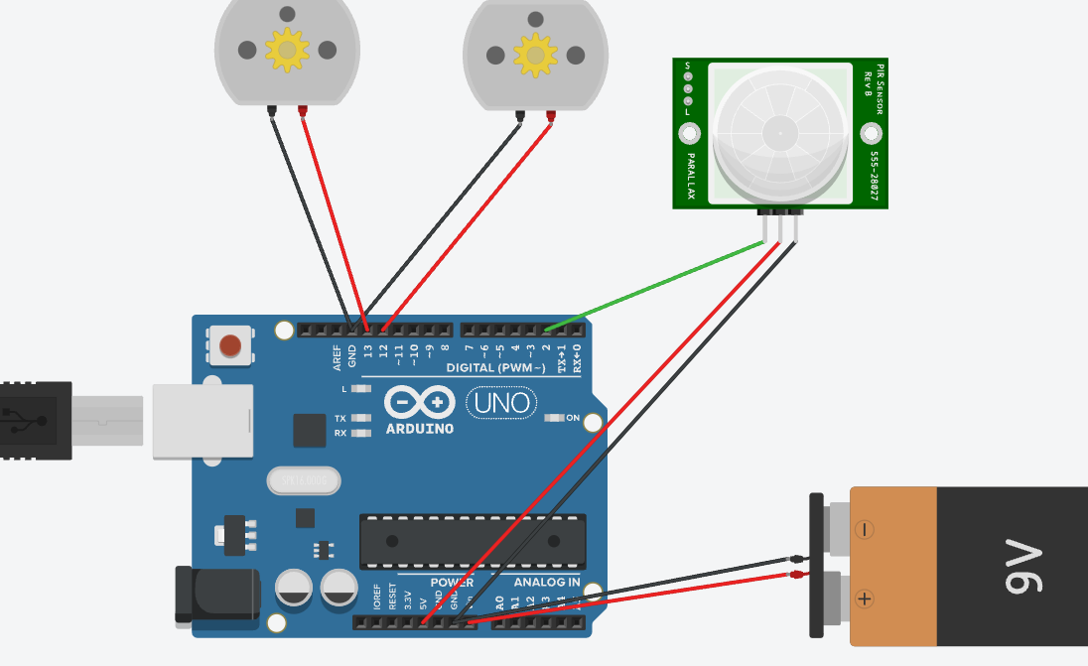
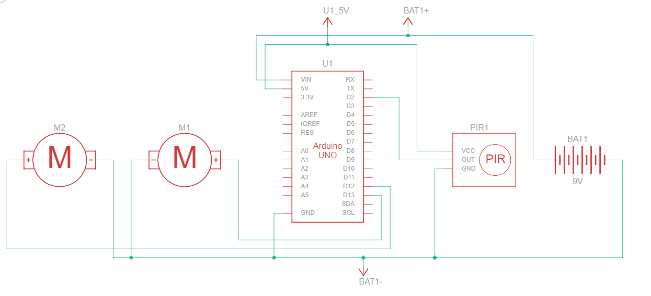
Circuit Diagram

Slide 13
Step by Step Procedure
Simulating the circuit: Creating a simulation of our electronic circuit on the Fritzing software and confirmed its working to be successful.
Writing the code on Arduino IDE, including the <Stepper.h> library for the stepper motor to control its working
Physically building the project: We ordered the components required for our project and started building the circuit. The circuit worked successfully and after testing it we made some final adjustments to the time delays of the motor.
Then build the 3D model of a the sliding door. The base and ceiling frame were built using wood and the sliding door was made from a rectangular pvc plane and hanged using a movable pipe to the ceiling.
Attach the Stepper motor and circuit to the door and tested its working to be succesfull

Slide 14
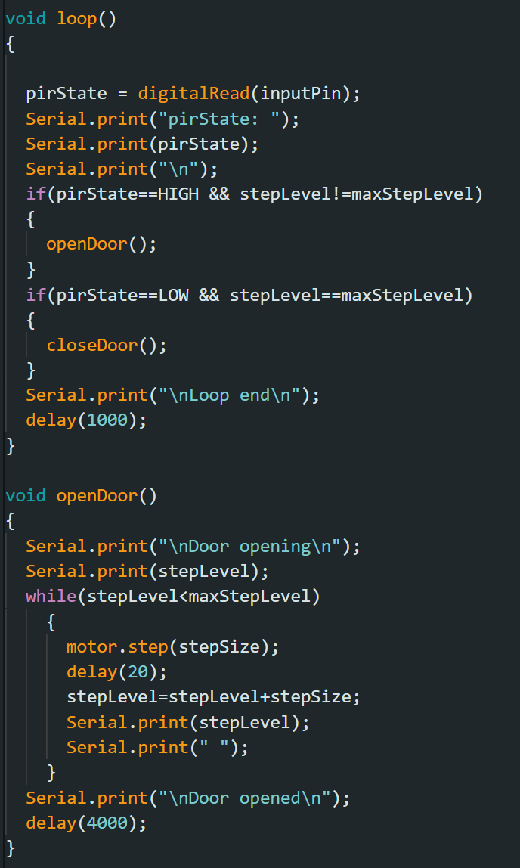
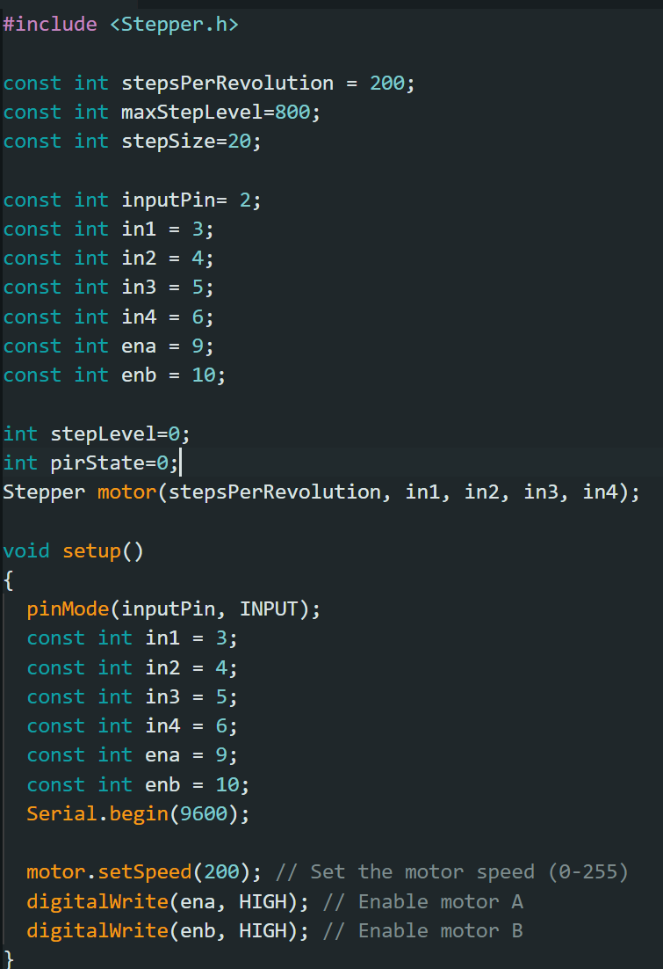
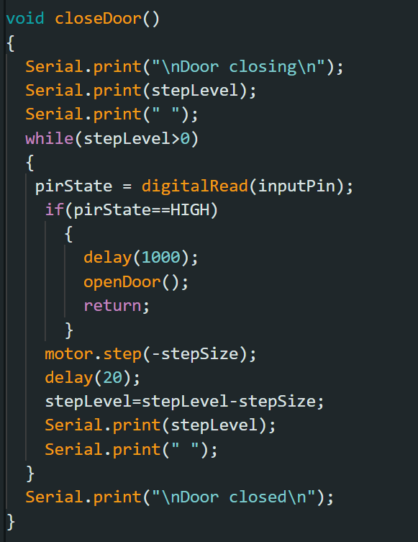
Arduino Code

Slide 15
Automatic Security Buzzer
Team 2

Slide 16
Material Required
Arduino UNO R3
PIR (Passive Infrared) sensor
Breadboard
9V Battery
Buzzer
Servo Motor
Insulated wires
Jumper wires
Door Lock

Slide 17
Project Plan
Build a the circuit by connecting the PIR sensor as an input to the Arduino board and a Servo motor and buzzer as output.
The PIR sensor will be placed in front of the main door to detect if someone is at the door through their motion
Use the PIR sensor’s input to the Arduino to switch on a buzzer and turn the servo motor to turn a knob and lock the door
The buzzer remains on for a set amount of time and the door remains locked for 10 hours minimum after which the circuit is reset
Attach the circuit outside the main door with the PIR sensor facing the entrance and the servo motor attached to the door lock

Slide 18
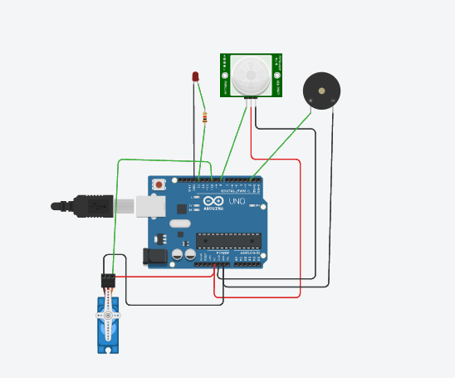
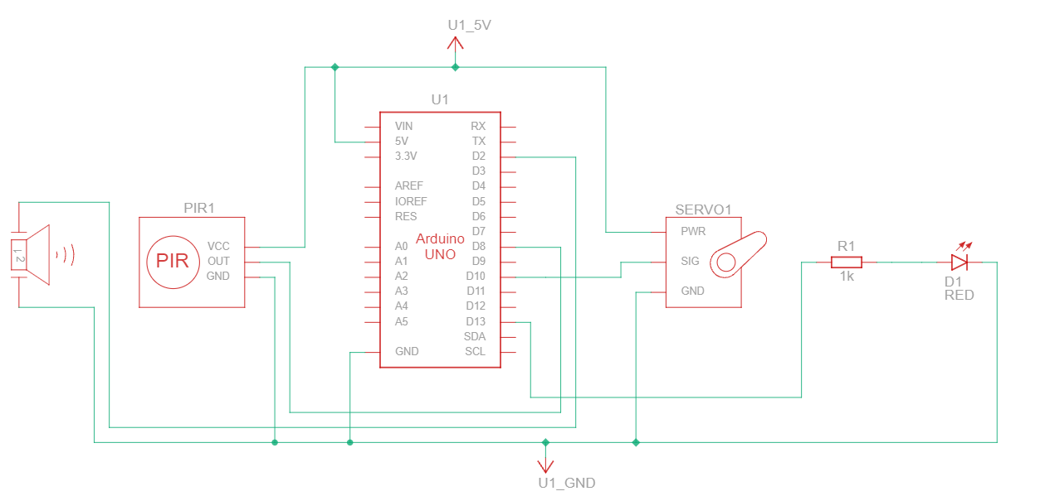
Circuit Diagram

Slide 19
Step by Step Procedure
Simulating the circuit: Creating a simulation of our electronic circuit on the Fritzing software and confirmed its working to be successful.
Writing the code on Arduino IDE, including time delays for the buzzer and Stepper motor
Physically building the project: We ordered the components required for our project and started building the circuit. The circuit worked successfully and after testing it we made some final adjustments to the time delays of the servo motor.
Attach the servo motor to the door lock and the circuit to the door and tested its working to be successful.

Slide 20
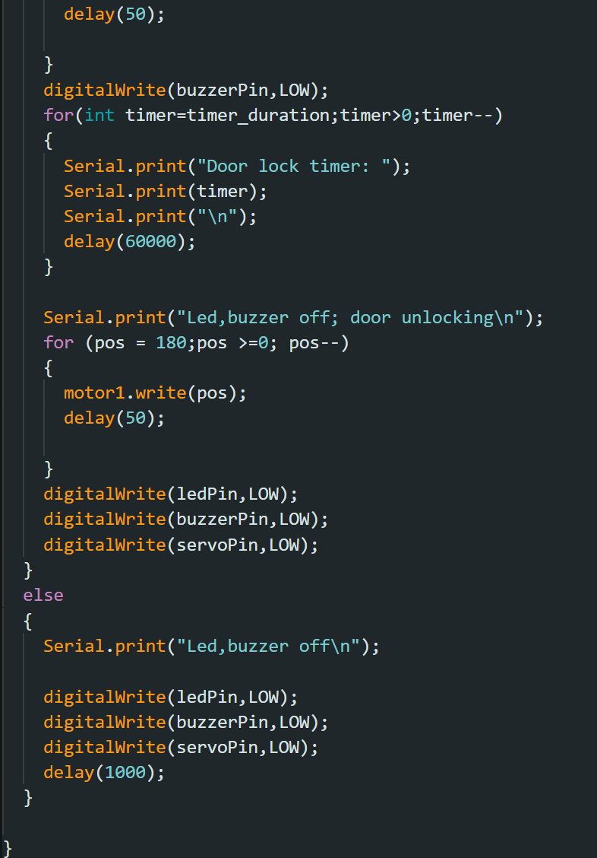
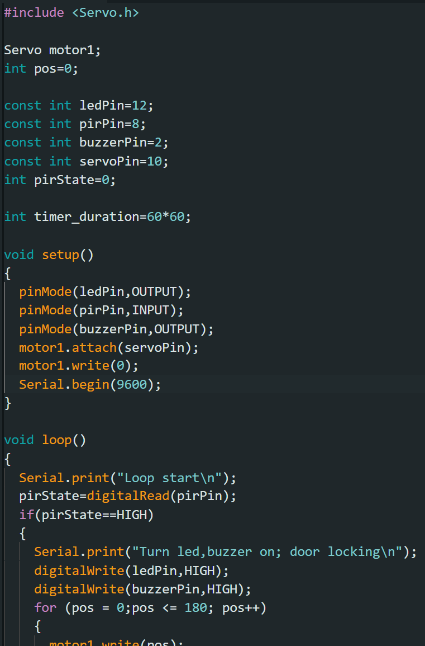
Arduino Code

